Slide 1
London Social Prescribing and Evaluation Showcase
November 2023
Jenny Brooks (TPHC)

Slide 2
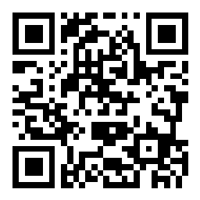
What is covered today
Topic | Time | Who
Background – importance of social prescribing impact and current activity | 10 min | Jenny Brooks (Programme manager – TPHC)
National Academy of Social Prescribing - our commitment to social prescribing evidence and impact | 5 min | Katy Knight - Senior Evidence and Evaluation Specialist – NASP) Anthea Terry - (Head of Evidence and Evaluation – NASP)
Live example - an ICB wide approach in North East London Template for capturing SP data and dashboard Perspective from a social prescribing link worker Impact of SP data from a GP perspective | 15 min | Lauren Moy (Programme manager - NEL ICB) Raquel Cerezo Martin (Social prescribing link worker Redbridge) Lisa Wolff (Social prescribing link worker – Havering) Victoria Tzortziou-Brown (GP Tower Hamlets, NHS NEL ICB Research and Innovation Lead)
Live example – a borough wide reporting approach in Barnet, led by Age UK social prescribing service | 15 min | Caitlin Bays (SP manager - Age UK) Seher Kayikci (Public Health Barnet)
The minimum dataset | 10 min | Denys Rayner (Project Manager Minimum Data Set Content & Launch – NHS England)
Q&A | 15 min | Jenny Brooks (Programme manager – TPHC)
Next steps | 15 min | Jenny Brooks (Programme manager – TPHC)
Breakout rooms - topical discussions hosted by our speakers | 20 min | Hosted by our speakers Social Prescribing reporting for services – Caitlin Bays The national minimum data set – Denys Rayner Supporting voluntary sector impact – Katy Knight and Anthea Terry ICB support for SP impact – Lauren Moy
Close
Join the Slido to share your reflections throughout
Slido.com
#SPEVAL
Notes:
Lunch will be provided at around 1pm for both of the in person sessions
This includes a selection of vegetarian and vegan sourdough sandwiches with crisps as well as a soup of the day option
Please let us know before the end of the day today if you have any preferences for any of these options or if you have any concerns

Slide 3
Why is evaluation and demonstrating the impact of Social Prescribing important?
Supports investment in social prescribing and prevention across sectors, particularly VCSE
Influences decision making and better targeting of resource to tackle inequality
Enables better understanding of local populations, development of shared insight for effective neighbourhood teams
Ensure social prescribing remains business as usual by evidencing value
These ambitions align with core NHS targets, mandates and plans for improvement, including:
ICB statutory requirements
Hewitt ICS report
ICB/ICP integrated care 5 year strategies, informed by joint needs assessments
PCN DES, Personalised care and Health Inequalities Supplement
Modern general practice
Plan for recovering access to primary care
Fuller Stock Take report
National NHS Inclusion health framework
CORE20PLUS5
Read our summary slides on policies, with key messages here.

Slide 4
What we’re doing in London
Social Prescribing and Evaluation Community of Practice
Monthly sessions sharing best practice, holding discussions and helping co-producing plans for regional support in this area
Open to all roles at any level. Get in touch if you’d like to join. We are reviewing the group in the new year.
What this has led to…
Case studies and mapping of examples – to be published soon
Paper on how VCSE and Health can work together to demonstrate impact
Working with Office of National Statistics to identify improvements to ONS-4
We held a London wide feedback session, which provided amazing insight
Now we are planning activity in response to feedback to support use of ONS-4 nationally
Upcoming support – to be released early 2024
The London Social Prescribing Evaluation Toolkit
Plans and content co-produced with a group of SPLWs, managers and PCN managers
Currently developing content with the system
Social Prescribing and Evaluation case study series
Detailed examples of:
How social prescribing is being evaluated across London
What is supporting services to evaluate

Slide 5
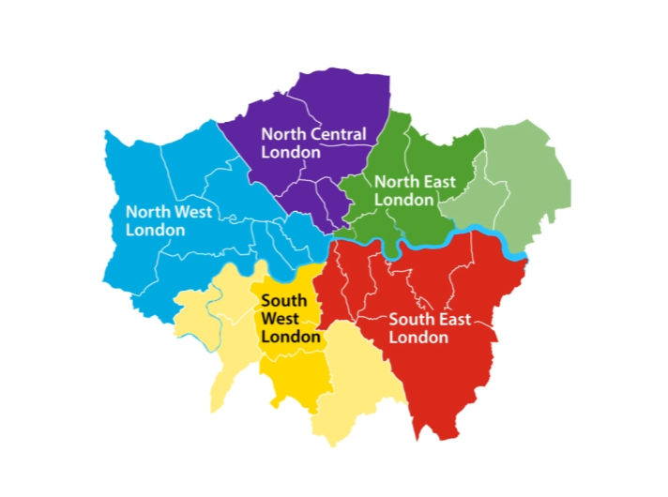
NCL
Developed list of recommended patient outcome measures for SP
Looking at what outcomes are being captured across different boroughs to understand how consistency could be improved
ICB wide use of MyCaw as part of Long Terms Conditions work within personalised care support planning.
Wide variety of case management systems being used
Supports Pop health strategy
NEL
Pilot site for National Minimum data set work
Developed template for EMIS/SystmOne/Joy including minimum dataset and extra information
Data is feeding into the ICB wide PowerBI dashboard
They hold a regular evaluation group focused on embeddingr data collection into SPLW consultations and data analysis using the dashboard
Barnet, Age UK:
Borough wide system for regular reporting SP data. Working with public health on yearly report and GP attendance yearly report, linking data. Elemental shares a gap report about services with SPLWs.
NWL
Commissioning Joy across all boroughs for Social Prescribing
Working with NAPC (National Association of primary care) on evaluation. Action Learning Sets being undertaken with each borough to look at:
Controls: Tools and Technology within the work systems; Colleagues: People's behaviours, the process used, culture of MDTs etc; Caseloads: patient management, task generation, onwards support, patient activation.
Evaluation frameworks being designed by 3ST (VCSE alliance) and the Bi-borough partnership
Camden: Working to embed evaluation in VCSE employers and SP, working with UCL evaluation exchange
Tower Hamlets: Co-produced 6 outcome, 40 indicator measure what makes a good life (BBBC). Rolling this out for SPLWs and wider.
Harrow:
Used data from Joy on services, to support recommissioning of Housing support
Lambeth: Social prescribing innovators project designed a process for evaluation with SPLWs at the core including joint staff and resident feedback forums, and yearly report
Westminster:
Holding borough wide group for all connector roles – called Octopus, now looking at KPIs for services, to show impact
Merton:
Undertook separate evaluations of HWBCs and SPLWs
Hammersmith and Fulham: Healthwatch is carrying out an evaluation of the SP service
Bromley:
Collecting monthly cumulative referrals via EMIS (GP fed)
SP activity providers are running their own evaluation – Bromley Well.
Healthwatch evaluation of SP service at the patient, SPLW and GP level
Sutton:
Procured Joy and has designated a lead to implement the system.
Southwark: Feedbacks data on gaps across borough to ICBs to inform commissioning through SP oversight group.

Slide 6
NASP Evidence Team
29th London TPHC Showcase Event
Anthea Terry – NASP Head of Evidence and Evaluation
Katy Knight – Senior Evidence and Evaluation Specialist – Evaluation specialism

Slide 7
What we will talk about today
What do we know about VCSE evaluation of social prescribing and how to support it?
What is NASPs role in social prescribing evidence and evaluation?
What are the opportunities for collaboration?
Notes:
What do you feel is the state of the evidence?

Slide 8
What is NASPs role in social prescribing evidence and evaluation?
We bring stakeholders together to share knowledge, identify and address evidence gaps, research challenges and opportunities through collaboration, being convenors and communicators of evidence, and increasing capability for evidence-based approaches.
Notes:
Identify and address strategic evidence needs and establish a cross sector and establish evidence advisory group to oversee this.
Work alongside the Global Social Prescribing Alliance to develop and expand our International Evidence Collaborative (IEC). Support the IEC to adopt and advance a shared strategic research agenda
As an evidence based organisation we will continue to ensure that all NASP activity is informed by best available evidence.

Slide 9
Where does the evidence come from?
Academic research
Evaluations from other SP projects (private, charitable, other government depts)
Individual
Referrer
Link worker function
VCSE provider/ activities
NHS patient records
Demographics
Social determinants (e.g. deprivation)
Other contextual factors
NHS data, various sources/systems and scales:
E.g. GP appts; SNOMED codes; secondary care admissions, etc.
Evaluations
Small scale
Variable
Non-specialists
Notes:
Simple diagram that only represents one of the multiple pathways for people to be connected with activities
Even this simple diagram immediately draws out some of the key evidence challenges:
Many stakeholders across multiple sectors. Simply knowing what is out there/who is doing what is an immense task
inconsistent evaluations (different data collected; often disconnected from health data)
Access to NHS data – hidden treasures
Specialist data analysis skills required
Significant methodological challenges in measuring some benefits of SP (trying to compare a totally different treatment pathway with e.g. trad health interventions)

Slide 10
Highest priority needs
Develop better ways to report on the economic value of social prescribing in the UK
Support VCFSE organisations in the UK to deliver evaluations of social prescribing that are of use to them and to their commissioners
socialprescribingacademy.org.uk/evidence-on-social prescribing/
Sign up to the evidence collaborative here.
Notes:
Develop better ways to report on the economic value of social prescribing in the UK (across all sectors but with focus on expressing value to the health sector in the immediate term)
Support Voluntary, Community, Faith and Social Enterprise organisations in the UK to deliver evaluations of social prescribing that are of use to them and to their commissioners (and that will encourage more consistent evaluation approaches)
The aim is that both these strands of work over the next 3 years will move us towards being able to justify the cost effectiveness of SP and for activity providers to be able to report more easily on key common metrics such as wellbeing, volunteering, loneliness, and impact on the health system (eg impact on GP appointments, pharma prescribing , A&E attendances).
These 2 pieces of work are intimately linked, as justifying the value/cost effectiveness of SP will rely on more effective evaluation of the costs of delivering SP activities by the VCFSE sector.

Slide 11
Supporting the VCFSE sector to evaluate social prescribing Dr Marie Polley, Abby Sabey, Dr Helen Seers, Professor Helen Chatterjee
Rapid scoping review aimed to:
Identify and collate resources to support evaluations of SP programmes
Assess the appropriateness/quality of these resources
Headlines:
61 resources identified that met inclusion criteria
15 comprehensive toolkits
13 partial toolkits
33 resources focused on one aspect of evaluation
Developing a shared language across sectors could facilitate a more consistent approach (glossary of evaluation terms could be produced)
Difference in cultures across funders/sectors is a limitation on evaluation activity
A range of learning and training needs were identified

Slide 12
What next?
What works for whom?
Better evidence on:
particular population groups
specific conditions
health inequalities
…for both intervention and implementation
Consistency and consensus
Simple, consistent impact measures for evaluation
‘Gold standard’ measures for economic impact/service usage
Data sharing
Alternative ways to evaluate

Slide 13
Live example - an ICB wide approach in North East London
Lauren Moy (Programme manager - NEL ICB)
Raquel Cerezo Martin (Social prescribing link worker Redbridge)
Lisa Wolff (Social prescribing link worker – Havering)
Victoria Tzortziou-Brown (GP Tower Hamlets, NHS NEL ICB Research and Innovation Lead)

Slide 14
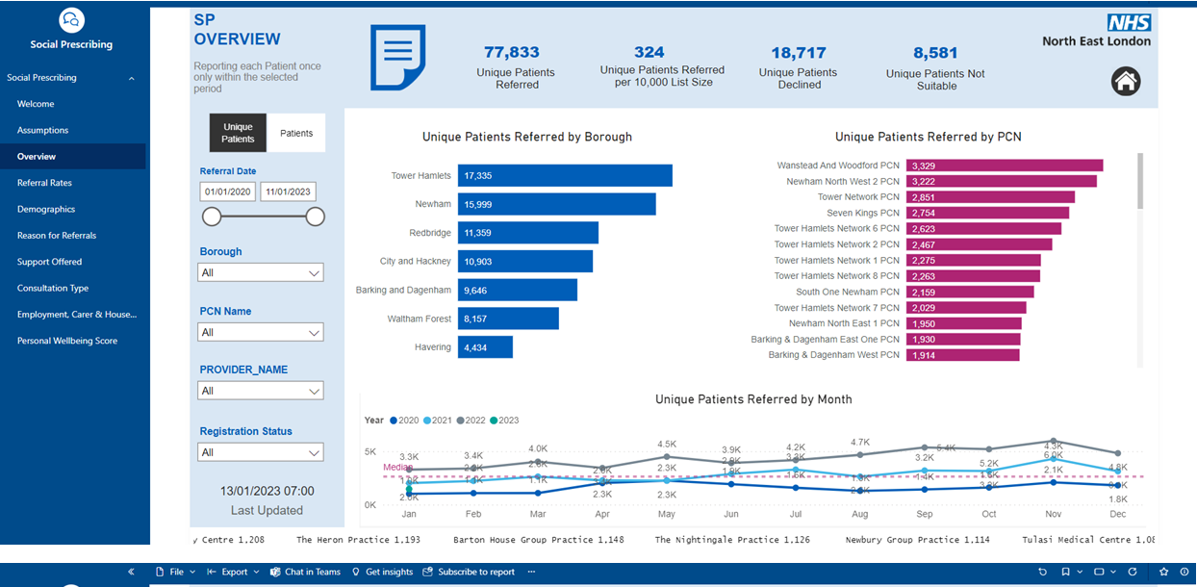
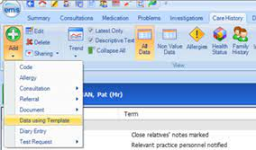
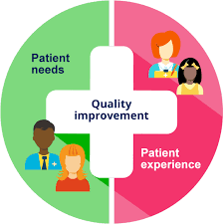
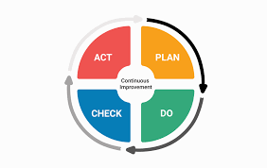
Minimum dataset – Template & Dashboard
14 SP Teams across 45 PCNs
Social Prescribing Evaluation Group
Minimum dataset
Procurement of CMS / DoS
Dashboard
EMIS/SystmOne template
Quality Improvement
Improvement cycle

Slide 15
Social Prescribing Reporting and Evaluation in Barnet
Caitlin Bays - Social Prescribing Manager
Seher Kayikci - Senior Public Health Strategist
29/11/23

Slide 16
Barnet SP Reporting
Case Management System: Elemental (Funded by PH and ICB)
Reporting duties: SP Manager – (Age UK Barnet)
Report Recipients: PCNs, Barnet Federated GPs, Public Health, Age UK Barnet, ICB and Health and Wellbeing Board.
Frequency: Monthly, Quarterly and Annually.
Types: Excel and Presentation formats.
Content: Service Utilisation, Referral Reasons, Appointment information, Demographics, Onward Referrals, Outcomes, Feedback, Gaps in services, Updates.

Slide 17
Evaluation
Annual cycle of evaluation conducted by Public Health.
Purpose:
Patient outcomes: Measured via ONS 4, demonstrates personal well-being on the four outcomes measures – satisfaction, worthwhile, happiness and anxiety. In addition, patient feedback survey results.
Impact evaluation: analysis of EMIS data, demonstrates the benefits of the service to the system – GP and A&E attendance.
Limitations / Challenges:
Outcomes include GP attendance reviews which are manually done through EMIS – EMIS access is limited for analytic staff not directly employed by PCN.
Covid 19 skewed data analysis for the early years of the service.

Slide 18
Evaluation: Impact for the PCNs and the Service
Showcase the value of the service and made a case for embedding Social Prescribing into PCNs as well as outlining where higher engagement is needed.
PCNs use the reports to support project work (e.g. health inequalities, winter pressures etc) and provide insight into the needs of their population.
Measuring patient outcomes helps identifying successes and improvements needed in our service (ONS, GP attendance and feedback survey - asks patients how we can improve our service).

Slide 19
Wider Impact of the Reports
Annual cycle of reporting to the Health and Wellbeing Board to raise of awareness of the needs and to demonstrate success of the service.
Public Health used the reports for informing the Community Innovation Funding decision making. The funding is used where higher needs are.
Social Prescribing reports are used to generate discussions to develop borough’s Neighbourhood Model across the ICB, the Council and VCSE.
Helps identify needs and trends, informing local commissioners and projects such as: MH transformation, Healthwatch, Adult social care commissioners. Using these report to understand, Utilisation and needs and onwards signposting and resources suggested.
Community organisations have used the reports to help identify service needs in the borough, for example, Age UK Barnet have responded to fulfil a service gap identified for older adults as well as sharing knowledge and insight to the Age-Friendly Barnet programme.

Slide 20
The Minimum Dataset and Information Standard
The background and rationale behind the launch of the new Social Prescribing Minimum Data Set and Information Standard

Slide 21
What is the Information Standard?
The Social Prescribing Information Standard has been designed to aid the sharing and recording of information for the whole patient journey. This is from an initial referral, includes the various meetings and support offered through to the message back to the referrer and GP at its conclusion.
The standard is all about the recording and sharing of information within social prescribing which includes:
Information required to support the conversations between the link worker and the client
Information to support people, showing that their healthcare is joined up and avoids them having to retell their story multiple times
Providing information that can be shared with the person themselves, their family or carer
Summary information back to the referrer and GP for the person’s overall record
Information for commissioning uses, e.g. to understand the scale and effectiveness of social prescribing services, aid future planning and support population health initiatives etc.

Slide 22
Why has the Information Standard been created?
Our health and care information isn’t all recorded in a single place but in many different systems. When we go to hospital or to a GP surgery, a record of the conversation between the person and clinician is made, including any decisions and actions taken. Records are created in other settings too, such as care homes. A care and support plan agreed between the resident and care home staff is recorded in a care home record system.
People access care in many more settings today than they ever did before, and for professionals and people themselves to have a complete picture of a person’s health and care, we need to join all these many records together, so information follows the person whenever and wherever care is provided
Recording information consistently
For information to flow between systems, it needs to be organised and recorded in the same way every time.
Agreed national standards and definitions must be used so that any computer can reproduce it with the same meaning.
Right place, right time
When information standards are implemented by care providers and their computer system suppliers, information will be recorded consistently across different settings.
This enables meaningful information to be made available to the right professionals at the right time, so it can be used to inform decisions about the care of the person.
Information tailored for different needs
Not everyone we interact with needs to see all the information in these records to advise us on what tests we might need, or diagnose a condition, or meet our care and support needs, but they might need to see some information from more than one record.

Slide 23
What is the Minimum Data Set?
The Minimum Data Set is a sub section of the Information Standard and consists of four sections of terms supported by SNOMED codes. These sections are:
Demographic information
Needs & Concerns
Support
Measures
There are now 78 agreed terms (excluding outcomes) that provide descriptions with the aim to collect these nationally
These are all available on the various core GP IT systems and on recommended Social Prescribing specific systems, and if used they can record the terms and coding
We know that there will be some SPLWs who do not have access to these systems, however it will be possible either to collect them manually in a data sheet or via a template such as Ardens
As there are only a limited number of codes the terms are at a high level so it is understood that they will have to be interpreted as the best fit and you may wish to add additional terms for your own benefit
It is intended to add to the data set in time following experience of the roll out

Slide 24
Why are we doing this?
One of the key aims is to ensure that the person only needs to provide their information once and this is expected to greatly improve their experience
This will help any clinician supporting the individual to see their overall needs in their care plan, and will improve their understanding in future consultations to provide the best care
Commissioners will have a better understanding of the needs and support required of a locality to ensure that they are providing the right support
It will benefit Link workers by demonstrating the benefits of the work that they are doing to the wider system and profiling the value of the service
Many link workers are concerned that their referrers do not always understand the work that they are doing and this will help improve the awareness and support better referrals and feedback using simple dashboards
With the roll out of Population Health and the reliance on SPLWs to support the initiatives this will improve the data provided to support the various initiatives within communities
This will be the first time that there has been an opportunity to provide national feedback on the work that Social Prescribers are doing

Slide 25
How did we develop the terms?
This piece of work has been 3 years in the making
We have engaged with stakeholders consisting of those with lived experience, link workers, business managers, regional teams, researchers and other social prescribing professionals
In addition, we have worked with the major software suppliers to ensure that they are ready to support the MDS
There have also been several pilots nationally and linking into the experience of well-respected long-term practitioners who have helped us refine the terms
We also looked at existing SNOMED codes and sought to not duplicate where at all possible
We have however developed several new codes for this exercise

Slide 26
Minimum Dataset Terms
Demographic Information:
NHS NUMBER
POSTCODE OF USUAL ADDRESS
PERSON BIRTH DATE
PERSON STATED GENDER CODE
ETHNIC CATEGORY CODE 2001
Requires reasonable adjustment for health and care access (Equality Act 2010)
PERSON MARITAL STATUS
Pregnant
Religious or other belief system affiliation
Sexual orientation
Caring status
Young Carer?
Needs & Concerns:
Mental Health problem
Physical Health problem
Mobility Ddrugs
Unhealthy alcohol drinking behavior
Overweight
Underweight
Diet poor
Chronic pain
Dyssomnia
Needs assistance with shopping
Needs assistance at home
Lack of exercise
Victim of domestic abuse
Victim of discriminatory abuse
Difficulty communicating
Unable to perform information and communication technology activities
Relationship problem
Needs & Concerns Continued:
Parenting problem
Patient themselves providing care (finding)
Social isolation (finding)
Feeling lonely
Problem related to social environment
Bereavement due to life event
Employment problem
Not in employment, education or training
Housing unsatisfactory
Homeless
Transport problem
Unsatisfactory living conditions
Low income
Difficulty with money management
Difficulty obtaining food
Unable to heat home
Education problem
Support:
Structured physical activity programme
Support for self management
Transport education, guidance and counselling
Finances education, guidance, and counselling
Houses education, guidance, and counselling
Bereavement counselling
Advice about benefits
Employment support
Support with volunteering
Support for parent
Abuse counselling
Social care
Emotional and psychosocial support and education
Advice about support groups

Slide 27
Minimum Dataset Terms continued
Support Continued:
Caregiver support
Help with household management
Social support
Counselling
Alcohol abuse prevention education
Drug abuse prevention education
Health promotion education
Healthy eating advice
Signposting to training resource
Signposting to Volunteering activity
Support to creative activity
Signposting to nature-based activity
Signposting to childcare support resource
Signposting to peer support resource
Signposting to debt advice resource
Signposting to education resource
Measures:
National Wellbeing measure (ONS4)
Assessment using Personal Wellbeing Score
1. Overall, how satisfied are you with your life nowadays?
2. Overall, to what extent do you feel that the things you do in your life are worthwhile?
3. Overall, how happy did you feel yesterday?
4. On a scale where 0 is “not at all anxious” and 10 is “completely anxious”, overall, how anxious did you feel yesterday?
Measures continued:
Warwick-Edinburgh Mental Wellbeing Scales
Assessment using Warwick-Edinburgh Mental Well-being Scale
14-item scale WEMWBS score
2. Overall, to what extent do you feel that the things you do in your life are worthwhile?
3. Overall, how happy did you feel yesterday?
4. On a scale where 0 is “not at all anxious” and 10 is “completely anxious”, overall, how anxious did you feel yesterday?
Assessment using Short Warwick-Edinburgh Mental Well-being Scale
7-item scale WEMWBS score
Personalised Care:
Referral to social prescribing service
Social prescribing declined
Social prescribing case closed
Seen by health and wellbeing coach
Seen by care coordinator
Personalised Care and Support Plan agreed
Review of Personalised Care and Support Plan
Shared decision making
Has personal health budget

Slide 28
Q&A

Slide 29
Next steps
We will distil themes from today, share recording and key messages
Share any answers to questions we’ve taken away
Look out for the Social Prescribing and Evaluation Toolkit and contribute any examples, reports to be featured
Get in touch if you’d like us to develop an in depth case study on how you are measuring or reporting social prescribing impact in your area
jennifer.brooks14@nhs.net
6th December – NASP – the latest evidence for social prescribing webinar
7th December - data management in general practice -NHS/PRSB
looking at standardising the recording type of encounter/consultation, such as face-to-face consultations in the surgery, to improve the data available to practices, commissioners to support planning

Slide 30
Breakout rooms

Slide 31
Choose what room to join by following the links in the teams chat
Social Prescribing reporting for services – Caitlin Bays
The national minimum data set – Denys Rayner
Measuring impact and the VCFSE– Katy Knight and Anthea Terry
ICB support for SP impact – Lauren Moy
The Social Prescribing Evaluation Toolkit – Jenny Brooks (stay in the main room)

Slide 32
Themes from breakouts
Social Prescribing reporting for services – Caitlin Bays
People were interested in what are the benefits of different case management system. How do you evaluate when you don’t have one?
Who to raise the importance of having a case management system with for social prescribing and make the case?
What influence do case management systems have and how can we use this to make the case for investment in areas that don’t currently have a case management system?
ICB support for SP impact – Lauren Moy
Shared where funding came from for dashboard – used Digital First for ICB work and local authorities for case management systems .
Bringing SP data, GP data and secondary care data together – to do the analysis and in the dashboard
Discussed cohorts and long term conditions
Measuring impact and the VCFSE– Katy Knight and Anthea Terry
More training and skills building would be useful, especially for small VCSE organisations
Frustration that data is discussed at a level which is very different from small activity organisations – difficult for them to know what to gather and what would be useful
Tricky when its 1000s of different groups, should umbrella VCSE orgs support how they can enable
How can faith groups collaborate
Who and where does responsibility lie – ICB/LA/VCSE? it isn’t clear who should be driving and who is doing what
The national minimum data set – Denys Rayner
Discussed SP outcomes
Working with people with low level mental health- how do we document impact on this cohort and frequent flyers
Terminology is very high level and there isn’t much around CYP and CYP mental health specifically
Data requirements will evolve depending on what questions are being asked and what we need to answer

Slide 33
Resources
NASP Evidence resource database
Specific resources
This NASP webinar gives a comprehensive introduction to evaluating a social prescribing service.
This practical guide outlines how you can measure impact on wellbeing, focusing on community and voluntary sector.
A wealth of tools were created by The Inspiring Impact programme by NPC to support the community and voluntary sector to better collect, use and evaluate data.

